Slide 1
Art
Progression of Skills
2023-24

Slide 2
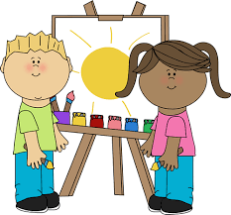
Progression Mapping

Slide 3
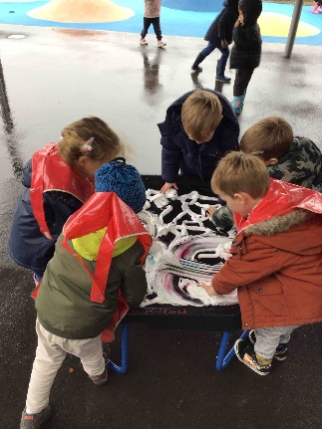
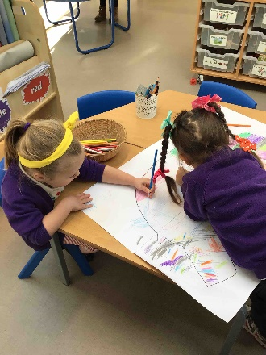
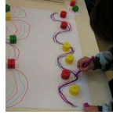
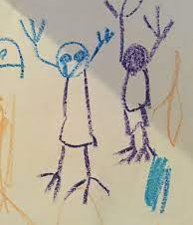
Art and Design: Drawing
Art and design area: Drawing |  | Year group: Nursery
What is drawing?
Prior learning | New learning | What success looks like: | Future learning
N/A | To explore and experiment with making marks using chalk, wax crayons, pencils, colouring pencils and felt tips. To use gross motor movements to create large marks- continuous rotations, push/pull, vertical arcs. To talk about marks and patterns created. | Children know that drawing tools create marks. Children can create large and small marks using tools. Children know the names of some drawing tools. | In Reception: That drawing tools create marks Name a range of drawing tools The names of different drawing tools including chalk, charcoal and pencils Where chalk and pencils come from
Key vocabulary | Expectations | End Point | Artist References
Mark Making- describes the different lines, dots, marks, patterns, and textures we create in an artwork. Patterns- a repeated decorative design. Lines- a mark made using a drawing tool or brush. |  | Know that drawings are marks left behind from dry media. Have experiments using a variety of dry media to create marks. Can name drawing tools; chalk, felt tips, pencils, crayons. | Varied – linked to books and artists throughout

Slide 4
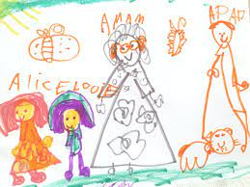
Art and Design: Drawing
Art and design area: Drawing |  |  |  | Year group: Reception
How can I use drawing to capture shapes around me?
Prior learning | New learning |  | What success looks like: | What success looks like: |  | Future learning
In Nursery . . . I know that drawing tools create marks. I know the names of basic drawing tools. | To explore making different marks with different resources and begin to compare lines and pastel smudges. To explore where chalk and pencils come from. To discuss marks and patterns created and begin to give reasons for their choices. Draw from memory and observation. |  | Children know the names of different drawing tools including chalk, crayons and pencils and understand their properties. Children begin to colour in-between lines with increasing accuracy. Children know that drawing tools create marks. Children demonstrate control over the types of marks made with a range of media such as crayons, pastels, felt tips, and chalk. | Children know the names of different drawing tools including chalk, crayons and pencils and understand their properties. Children begin to colour in-between lines with increasing accuracy. Children know that drawing tools create marks. Children demonstrate control over the types of marks made with a range of media such as crayons, pastels, felt tips, and chalk. |  | In Year 1 . . . Can use a variety of drawing media to invent new lines, marks and shapes. Can describe marks that they have made. Understands that lines and shapes are used by artists in a range of different ways to create final pieces. Knows some artists who use line and shapes in their art.
Key vocabulary | References | Expectations | End Point | End Point | End Point | Artist References | Artist References
Drawing- a picture or diagram made with a pencil, pen, or crayon rather than paint. Pencil- an instrument for writing or drawing, consisting of a thin stick of graphite or a similar substance enclosed in a long thin piece of wood. Crayon- a pencil or stick of coloured chalk or wax, used for drawing. Felt tip- a pen with a writing point made of felt or other tightly packed fibres. Mark Making- describes the different lines, dots, marks, patterns, and textures we create in an artwork. Chalk- a white soft earthy limestone. Patterns- a repeated decorative design. Lines- a mark made using a drawing tool or brush. |  |  |  | Know that drawings are marks left behind from dry media. Have experiments using a variety of dry media to create marks. Can name drawing tools; chalk, felt tips, pencils, crayons. | Know that drawing tools create marks. Can name drawing tools including chalk, charcoal and pencils. Can explain where chalk and pencils come from. |  | Varied – linked to books and artists throughout

Slide 5
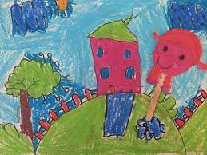
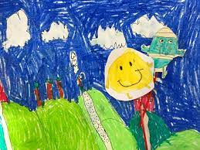
Art and Design: Drawing
Art and design area: Drawing |  |  |  | Year group: Year 1
How are lines and shapes used in drawings?
Prior learning | New learning |  | What success looks like: | What success looks like: |  | Future learning
In Reception . . . To explore making different marks with different resources and begin to compare lines and pastel smudges. To explore where chalk and pencils come from. To discuss marks and patterns created and begin to give reasons for their choices. Draw from memory and observation. | To explore a range of different drawing mediums to create and invent a range of lines and alter thickness using different mediums. To explore how famous artists use dots, lines and shapes to create works of art. To link a range of lines together to create a piece of artwork. To explore how shapes can be used to create a piece of artwork – particularly self-portraits. To experiment with overlapping shapes. |  | Children develop effective grip using smaller crayons, pencils and pens. Children describe lines, shapes and patterns created. Children demonstrate control when drawing using chalk, wax crayons, pencils, colouring pencils and felt tips. | Children develop effective grip using smaller crayons, pencils and pens. Children describe lines, shapes and patterns created. Children demonstrate control when drawing using chalk, wax crayons, pencils, colouring pencils and felt tips. |  | In Year 2 . . . . To explore lines and blending using pencils, pastels chalk and oil pastels. Choose when to use dots or lines to show texture or patterns. To study and analyse landscapes using artists vocabulary. To identify backgrounds and foregrounds in a landscape. To study landscapes created by famous artists. To use secondary source images to observe and draw a landscape. To create objects in the foreground that appear larger than those in the background.
Key vocabulary | References | Expectations | End Point | End Point | End Point | Artist References | Artist References
Drawing- A picture or diagram made with a pencil, pen, or crayon rather than paint. Line- Connection between two points. It can vary in length and size and direction. Shape- the form or outline of something. Observation- the action or process of closely observing or monitoring something or someone. Abstract- modern art which does not represent images of our everyday world. It has colour, lines and shapes (form), but they are not intended to represent objects or living things. | Drawing- A picture or diagram made with a pencil, pen, or crayon rather than paint. Line- Connection between two points. It can vary in length and size and direction. Shape- the form or outline of something. Observation- the action or process of closely observing or monitoring something or someone. Abstract- modern art which does not represent images of our everyday world. It has colour, lines and shapes (form), but they are not intended to represent objects or living things. |  |  | Know that drawings are marks left behind from dry media. Have experiments using a variety of dry media to create marks. Can name drawing tools; chalk, felt tips, pencils, crayons. | Can use a variety of drawing media to invent new lines, marks and shapes. Can describe marks that they have made. Understands that lines and shapes are used by artists in a range of different ways to create final pieces. |  | Roger Hargreaves

Slide 6
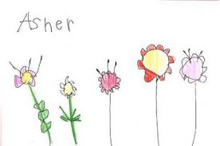
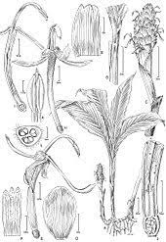
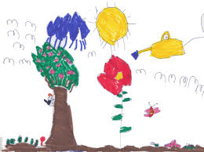
Art and Design: Drawing
Art and design area: Drawing |  |  |  | Year group: Year 2
How much detail is there in plants?
Prior learning | New learning |  | What success looks like: | What success looks like: |  | Future learning
In Year 1 . . . How lines are used in art… To explore a range of different drawing mediums to create and invent a range of lines and alter thickness using different mediums. To explore how famous artists use dots, lines and shapes to create works of art. To link a range of lines together to create a piece of artwork. | To explore lines and blending using pencils, pastels chalk and oil pastels. Choose when to use dots or lines to show texture or patterns – focusing on pointillism. To study and analyse landscapes using artists’ vocabulary. To identify backgrounds and foregrounds in a landscape. To study landscapes created by famous artists. To use secondary source images to observe and draw a landscape. To create objects in the foreground that appear larger than those in the background. |  | Children continue to develop an effective pencil grip when using smaller drawing tools. Children begin to add detail to picture and begin to use side of pencil to add shading detail. Children demonstrate control and accuracy when drawing using pencils, pastels, charcoal, chalk and oil pastels. | Children develop effective grip using smaller crayons, pencils and pens. Children describe lines, shapes and patterns created. Children demonstrate control when drawing using chalk, wax crayons, pencils, colouring pencils and felt tips. |  | In Year 3 . . . . To explore and experiment with graded pencils to shown tone and texture and annotate findings in sketchbooks. To draw from first-hand observation and secondary sources images e.g. pictures and artists’ copies. To explore hatching and cross hatching to show tone and texture. To identify areas of shadow and light and blend tones accurately to create soft gradients. Draw on a range of different scales.
Key vocabulary | References | Expectations | End Point | End Point | End Point | Artist References | Artist References
Landscape- a picture representing a view of natural inland scenery. Background- The ground or parts of a scene that are behind the main subject of the artwork. Horizon- the line where the earth or sea meets the sky. Middle ground- the middle distance of a painting or photograph. Foreground- The ground or things placed in the front of the picture. Observation- the action or process of closely observing or monitoring something or someone. Blending- the technique of gently intermingling two or more colours or values to create a gradual transition or to soften lines. | Drawing- A picture or diagram made with a pencil, pen, or crayon rather than paint. Line- Connection between two points. It can vary in length and size and direction. Shape- the form or outline of something. Observation- the action or process of closely observing or monitoring something or someone. Abstract- modern art which does not represent images of our everyday world. It has colour, lines and shapes (form), but they are not intended to represent objects or living things. |  |  | Know that drawings are marks left behind from dry media. Have experiments using a variety of dry media to create marks. Can name drawing tools; chalk, felt tips, pencils, crayons. | Can identify what a landscape is. Can identify a foreground and background in a landscape. Understands how to use and look after oil pastels. |  | Alice Tangerini

Slide 7
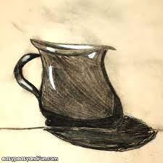
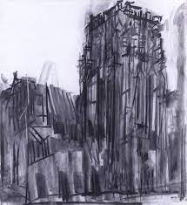
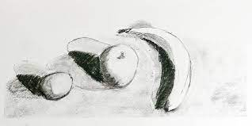
Art and Design: Drawing
Art and design area: Drawing |  |  | Year group: Year 3
How can i capture tone and shade using charcoal and chalk?
Prior learning | New learning |  | What success looks like: |  | Future learning
In Year 2 . . . To explore lines and blending using pencils, pastels chalk and oil pastels. Choose when to use dots or lines to show texture or patterns. To study and analyse landscapes using artists vocabulary. To identify backgrounds and foregrounds in a landscape. To study landscapes created by famous artists. | To explore and experiment with graded pencils to shown tone and texture and annotate findings in sketchbooks. To develop charcoal skills by using the edge to create tone, pressing hard to make dense marks and using your finger to smudge Use drawing materials that are appropriate for different weathers – such as a stormy sea or a calm sky To draw from first-hand observation and secondary sources images e.g. pictures and artists’ copies. To explore hatching and cross hatching to show tone and texture. To identify areas of shadow and light and blend tones accurately to create soft gradients. Draw on a range of different scales. |  | Children use an eraser to expose lighter tones to show texture in an artwork. Children Children know that H pencils are hard and will produce light marks – best for technical drawing. Children use different parts of charcoal to create effects Children know that B pencils are soft and will produce darker tones – best used for tonal drawings and shading. |  | In Year 4. . . . To explore blending lines to create different shades and tones with different drawing mediums. Select which grade of pencil would be best to use on the chosen area to create line, tone and texture. To explore how light and shadow is captured in the correct areas with knowledge of light source. To draw from observation and apply shades and tones. To refine techniques when using oil pastels and blend colours to create different tones and shades. .
Key vocabulary | References | Expectations | End Point | End Point | Artist References | Artist References
Hatching / Cross hatching- techniques used by draftsmen, engravers, and other artists who use mediums that do not allow blending. Textures- one of the seven elements of art that refers to the visual "feel" of a piece. Reflection- when light bounces off an object. Shades- the darkening or colouring of an illustration or diagram with parallel lines or a block of colour. First-hand observation- when you look at surroundings and you draw what you see first. Secondary source images - material produced by others. e.g artefacts, photographs, film, video or web-based material. | Drawing- A picture or diagram made with a pencil, pen, or crayon rather than paint. Line- Connection between two points. It can vary in length and size and direction. Shape- the form or outline of something. Observation- the action or process of closely observing or monitoring something or someone. Abstract- modern art which does not represent images of our everyday world. It has colour, lines and shapes (form), but they are not intended to represent objects or living things. |  | Know that drawings are marks left behind from dry media. Have experiments using a variety of dry media to create marks. Can name drawing tools; chalk, felt tips, pencils, crayons. | Know different pencil grades and can select these for purpose. Know how to use charcoal in different ways to create different effects. Know how to use hatching and cross hatching to show tone and textures in drawings. |  | Dennis Creffield

Slide 8
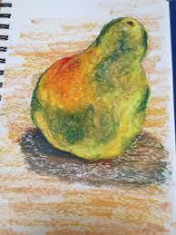
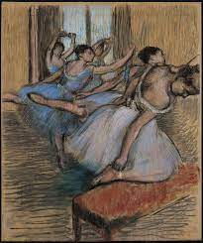
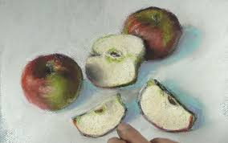
Art and Design: Drawing
Art and design area: Drawing |  |  | Year group: Year 4
How are shadows created in using pastels?
Prior learning | New learning |  | What success looks like: |  | Future learning
Year 1- How are line used in art? Year 2- How are shapes and lines used to create landscapes? Year 3- How is hatching and cross hatching used to create tones in drawings? | To explore blending lines to create different shades and tones with different drawing mediums. To explore how light and shadow is captured in the correct areas with knowledge of light source. To draw from observation and apply shades and tones. To refine techniques when using oil pastels and blend colours to create different tones and shades. |  | Children clearly mark areas of light and shadow in an observational drawing. Children know how to draw and blend lines to create different textures, shades and tones. Children begin to select colours for purpose. Children know how to create contrast and tone in drawings. |  | In Year 5. . . . To use a range of mark making techniques to show contrast and tone in drawings. To make small studies from observation using viewfinders to focus on selected parts. To apply drawing skills using ink pens and explore the different properties. To draw from first-hand observation and from source material. To explore the work of famous architects and designers and experiment with some of these styles.. Begin to use perspective and proportion. Select an appropriate style of a piece of artwork
Key vocabulary | References | Expectations | End Point | End Point | Artist References | Artist References
Hatching / Cross hatching- techniques used by draftsmen, engravers, and other artists who use mediums that do not allow blending. Textures- one of the seven elements of art that refers to the visual "feel" of a piece. Reflection- when light bounces off an object. Shades- the darkening or colouring of an illustration or diagram with parallel lines or a block of colour. First-hand observation- when you look at surroundings and you draw what you see first. Secondary source images - material produced by others. e.g artefacts, photographs, film, video or web-based material. | Drawing- A picture or diagram made with a pencil, pen, or crayon rather than paint. Line- Connection between two points. It can vary in length and size and direction. Shape- the form or outline of something. Observation- the action or process of closely observing or monitoring something or someone. Abstract- modern art which does not represent images of our everyday world. It has colour, lines and shapes (form), but they are not intended to represent objects or living things. |  | Know that drawings are marks left behind from dry media. Have experiments using a variety of dry media to create marks. Can name drawing tools; chalk, felt tips, pencils, crayons. | Use shading to add interesting effects to drawings, using different colours of patels. Know how to draw from first-hand experience. Know how to select graded pencils for purpose.
Edgar Degas

Slide 9
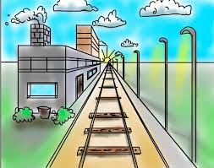
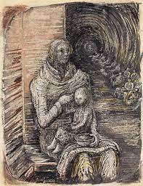
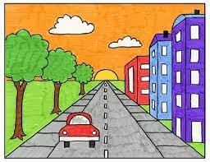
Art and Design: Drawing
Art and design area: Drawing |  |  | Year group: Year 5
How do I get depth into my drawings by using perspective?
Prior learning | New learning |  | What success looks like: |  | Future learning
Year 1- How are line used in art? Year 2- How are shapes and lines used to create landscapes? Year 3- How is hatching and cross hatching used to create tones in drawings? Year 4 – Know how to select graded pencil for specific purpose | To use a range of mark making techniques to show contrast and tone in drawings. To make small studies from observation using viewfinders to focus on selected parts. To apply drawing skills using ink pens and explore the different properties. To draw from first-hand observation and from source material. To explore the work of famous architects and designers and experiment with some of these styles.. Begin to use perspective and proportion. Select an appropriate style of a piece of artwork |  | Children are able to show contrast in terms of tone in their drawings. Children successfully use viewfinders to be able to focus on a given feature Children recognise the difference when using ink pens Children use their drawing techniques effectively to capture different observations. Children begin to use perspective in their drawing. Children known when it is appropriate to use close observation skills in their work |  | In Year 6. . . . Children should be able to use a full range of pencils, pastels, charcoal and mixed media to create observational art independently Children should know the effect of light on objects and people from different directions Children should use perspective in their work, using a single focal point and horizon
Key vocabulary | References | Expectations | End Point | End Point | Artist References | Artist References
View finder – this is a small hole, usually circular or square on a piece of card to allow a child to focus on a given area. Ink- as well as pencils, pastels and charcoal children should be introduced to ink work. Tone- this is how light or dark a picture is. Tone is very important to an artist because tone is often more important than colour. First-hand observation- when you look at surroundings and you draw what you see first. | Drawing- A picture or diagram made with a pencil, pen, or crayon rather than paint. Line- Connection between two points. It can vary in length and size and direction. Shape- the form or outline of something. Observation- the action or process of closely observing or monitoring something or someone. Abstract- modern art which does not represent images of our everyday world. It has colour, lines and shapes (form), but they are not intended to represent objects or living things. |  | Know that drawings are marks left behind from dry media. Have experiments using a variety of dry media to create marks. Can name drawing tools; chalk, felt tips, pencils, crayons. | Use ink to enhance the quality of their Know how to draw from use a viewfinder to provide a focus for children Know how to create perspective in drawing
Henry Moore

Slide 10
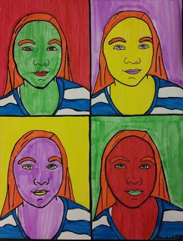
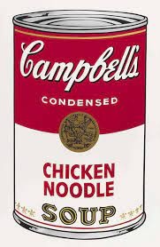
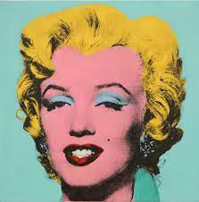
Art and Design: Drawing
Art and design area: Drawing |  |  | Year group: Year 6
How can I create a self-portrait using a range of mediums?
Prior learning | New learning |  | What success looks like: |  | Future learning
Year 1- How are line used in art? Year 2- How are shapes and lines used to create landscapes? Year 3- How is hatching and cross hatching used to create tones in drawings? Year 4 – Know how to select graded pencil for specific purpose Year 5 – Know how to use ink within their drawing and begin to use perspective. | Use a full range of pencils, pastels, charcoal and mixed media to create observational art independently Show effect of light on objects and people from different directions Know how tone can add impact to a drawing. Focus on a small area such as eyes or lips and be able to capture the different tones and shades. |  | Children should be able to decide which grade of pencil to use for a particular piece of art work. Children should also be able to decide when it is appropriate to use ink, pastels or charcoal. Children should be confident when using perspective and know about horizons. Children should know about the impact of tone in their drawing. |  | In Year 7. . . . Show increasing control with drawing with adventurous development using a range of increasing variety of tools to create specific effects. Emphasis on refinement and quality of finish Critically and technically analyse and evaluate own and others work, identifying key features, make comparisons and use information to inform developments.
Key vocabulary | References | Expectations | End Point | End Point | Artist References | Artist References
View finder - techniques used by draftsmen, engravers, and other artists who use mediums that do not allow blending. Ink- one of the seven elements of art that refers to the visual "feel" of a piece. Reflection- when light bounces off an object. Tone- the darkening or colouring of an illustration or diagram with parallel lines or a block of colour. First-hand observation- when you look at surroundings and you draw what you see first. | Drawing- A picture or diagram made with a pencil, pen, or crayon rather than paint. Line- Connection between two points. It can vary in length and size and direction. Shape- the form or outline of something. Observation- the action or process of closely observing or monitoring something or someone. Abstract- modern art which does not represent images of our everyday world. It has colour, lines and shapes (form), but they are not intended to represent objects or living things. |  | Know that drawings are marks left behind from dry media. Have experiments using a variety of dry media to create marks. Can name drawing tools; chalk, felt tips, pencils, crayons. | Decide on which range of pencils to use for specific tasks. Show confidence in using perspective in their drawings. Know the impact that tone has on a piece of work.
Andy Warhol

Slide 11
Progression Map for Drawing
Nursery | Reception | Year 1 | Year 2
To explore and experiment with making marks using chalk, wax crayons, pencils, colouring pencils and felt tips. To use gross motor movements to create large marks- continuous rotations, push/pull, vertical arcs. To talk about marks and patterns created. | To explore making different marks with different resources and begin to compare lines and pastel smudges. To explore where chalk and pencils come from. To discuss marks and patterns created and begin to give reasons for their choices. Draw from memory and observation. Introduce dark and light pencils (e.g., 8B and HB) | To explore a range of different drawing mediums to create and invent a range of lines and alter thickness using different mediums. To explore how famous artists use dots, lines and shapes to create works of art. To link a range of lines together to create a piece of artwork. To explore how shapes can be used to create a piece of artwork. To explore self-portraits to apply the dots, lines and shapes skills. To experiment with overlapping shapes. Confident in using pastels and charcoal | To explore lines and blending using pencils, pastels chalk and oil pastels. Choose when to use dots or lines to show texture or patterns. To study and analyse landscapes using artists’ vocabulary. To identify backgrounds and foregrounds in a landscape. To study landscapes created by famous artists. To use secondary source images to observe and draw a landscape. To create objects in the foreground that appear larger than those in the background. Add 2H to the pencil range.
Year 3 | Year 4 | Year 5 | Year 6
To explore and experiment with graded pencils to shown tone and texture and annotate findings in sketchbooks. To develop charcoal skills by using the edge to create tone, pressing hard to make dense marks and using your finger to smudge Use drawing materials that are appropriate for different weathers – such as a stormy sea or a calm sky To draw from first-hand observation and secondary sources images e.g., pictures and artists’ copies. To explore hatching and cross hatching to show tone and texture. To identify areas of shadow and light and blend tones accurately to create soft gradients. Draw on a range of different scales. Use chalk pastels and charcoal and chalk to create effect and depth, etc. | To explore blending lines to create different shades and tones with different drawing mediums. Select which grade of pencil would be best to use on the chosen area to create line, tone and texture. To explore how light and shadow is captured in the correct areas with knowledge of light source. To draw from observation and apply shades and tones. To refine techniques when using oil pastels and blend colours to create different tones and shades. Add 6B to the pencil range | To use a range of mark making techniques to show contrast and tone in drawings when creating perspective pieces. To make small studies from observation using viewfinders to focus on selected parts. To draw from first-hand observation and from source material. To explore the work of famous architects and designers and experiment with some of these styles.. Use perspective and proportion. Select an appropriate style of a piece of artwork | Use a full range of pencils, pastels, charcoal and mixed media to create observational art independently Show effect of light on objects and people from different directions Know how tone can add impact to a drawing. Focus on a small area such as eyes or lips and be able to capture the different tones and shades. Use perspective in their work, using a single focal point and horizon Add 4H to the pencil range. Experiment with ink.

Slide 12
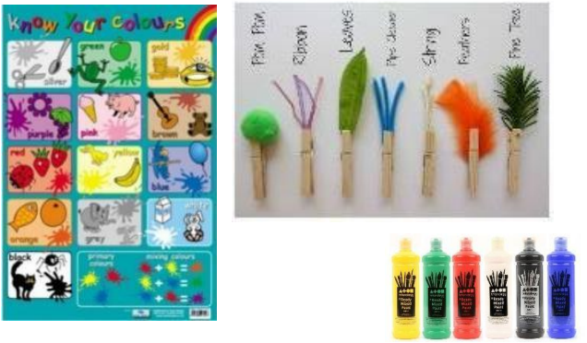
Art and Design: Painting
Art and design area: Painting |  | Year group: Nursery
What is painting?
Prior learning | New learning | What success looks like: |  | Future learning
N/A | To experiment with a range of painting tools such as thick and thin paintbrushes, spatulas, combs, toothbrushes. To explore and experiment with making marks using all paint tools above. To explore colour mixing using poster paint. | Colour names, yellow, red, blue, green, orange and purple (primary and secondary colours) The colours white and black. Know some different types of paint (watercolour and poster paint) |  | In Reception: To explore and refine colour mixing using namely poster paint. Use simple tools and techniques competently and appropriately.
Key vocabulary | References | End Point | End Points | Artist References | Artist References
Mark Making- describes the different lines, dots, marks, patterns, and textures we create in an artwork. Patterns- a repeated decorative design. Lines- a mark made using a drawing tool or brush. |  | Understands that paint can be applied in different ways. Can name simple colours. Can mix colours to match objects that they see. Can paint with different tools and recognize the effects | Understands that paint can be applied in different ways. Can name simple colours. Can mix colours to match objects that they see. Can paint with different tools and recognize the effects. | Varied – linked to books and artists throughout | Varied – linked to books and artists throughout

Slide 13
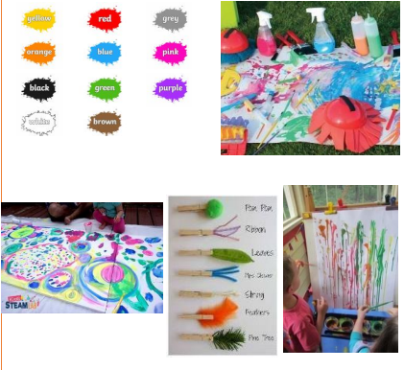
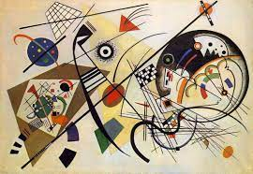
Art and Design: Painting
Art and design area: Painting |  |  |  | Year group: Reception
How can I be incredible as a real artist?
Prior learning | New learning |  | What success looks like: | What success looks like: |  | Future learning
In Nursery . . . Experiences with painting with different tools. Explored colours Combined collage and paint Matched objects and materials to colours | To experiment with a range of painting tools such as thick or thin paintbrushes, fingers, spatulas, combs, toothbrushes etc. To name a range of different colours. To mix paint to match colours they see. To explore and refine colour mixing using poster paint. To combine paint and collage. To offer viewpoints of paintings. |  | Children begin to develop control when using a variety or standard and self-made painting tools. Children describe textures and techniques - for example, 'thick', 'thin', 'wet', 'dry' and 'dribble', 'splatter' and 'drip'. Children begin to show control when using a variety of standard and self-made painting tools. | Children know the names of different drawing tools including chalk, crayons and pencils and understand their properties. Children begin to colour in-between lines with increasing accuracy. Children know that drawing tools create marks. Children demonstrate control over the types of marks made with a range of media such as crayons, pastels, felt tips, and chalk. |  | In Year 1 . . . To explore primary and secondary colours. To represent primary and secondary colours on a colour wheel. To experiment with warm and cool colours. To paint from observation. To combine paint and collage.
Key vocabulary | References | References | End Point | End Point | End Point | Artist References | Artist References
Painting- the action or skill of using paint, either in a picture or as decoration. Artist- a person who creates paintings or drawings as a profession or hobby. Collage- a piece of art made by sticking various different materials such as photographs and pieces of paper or fabric on to a backing. Paint- a coloured substance which is spread over a surface and dries to leave a thin decorative or protective coating. Vocabulary to describe paint: Thick, thin, wet, dry, dribble, splatter, drip |  |  |  | Know that drawings are marks left behind from dry media. Have experiments using a variety of dry media to create marks. Can name drawing tools; chalk, felt tips, pencils, crayons. | Knows that paint can be applied in different ways. Can name simple colours. Can mix colours to match objects that they see. Can combine paint and collage to produce a work of art. |  | Varied – linked to books and artists throughout Wassily Kandinsky

Slide 14
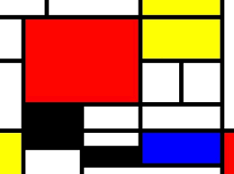
Art and Design: Painting
Art and design area: Painting |  |  |  | Year group: Year 1
How can I mix paint to get the colour I want to use?
Prior learning | New learning |  | What success looks like: | What success looks like: |  | Future learning
In Reception .. Reception key question: How can paint be applied in different ways to create different textures? Know that paint can be applied in different ways. Understand that paint can create different textures. Understand how to change properties of paint using water | *To explore primary and secondary colours. *To represent primary and secondary colours on a colour wheel. *To identify and experiment with warm and cool colours. *To paint from observation. *To explore primary and secondary colours. *To represent primary and secondary colours on a colour wheel. *To identify and experiment with warm and cool colours. *To paint from observation. | To explore primary and secondary colours. To represent primary and secondary colours on a colour wheel. To identify and experiment with warm and cool colours. To paint from observation. | Children select thick and thin paintbrushes for purpose Children hold thick and thin paintbrushes close to the end for control and detail. Children show control when using painting tools. Children mix colours using poster paint, powder paint and watercolour. Children understand the different properties and discuss artist’s work Children comment on the warm and cold colours in the work of Joan Amara and Georgia O’Keeffe and recreate their work and similar from observation |  |  | In Year 2 … To explore creating tints and shades in a variety of different colours. To experiment with different painting effects such as washes, blocking and thickened paint. To explore paint effects and techniques used by famous artists. (Claude Monet and Paul Klee) To explore texture in an artwork using techniques such as layering, differing brush strokes or varying equipment such as a sponge or spatula. | To explore creating tints and shades in a variety of different colours. To experiment with different painting effects such as washes, blocking and thickened paint. To explore paint effects and techniques used by famous artists. (Claude Monet and Paul Klee) To explore texture in an artwork using techniques such as layering, differing brush strokes or varying equipment such as a sponge or spatula.
Key vocabulary | References | References | End Point | End Point | End Point | Artist References | Artist References
Primary colours- The primary colours are those which cannot be created by mixing other colours in a given colour space. Secondary colours- A secondary colour is a colour made by mixing of two primary colours. Colour wheel- A colour wheel shows you how colours relate to each other cold and warm colours Warm colours — one side of the colour wheel that includes red, yellow, and orange. This evokes warmth because they remind us of things like the sun or fire. Cool colours — the other side of the colour wheel that includes blue, green, and purple. This evokes a cool feeling because they remind us of things like water or grass. |  |  |  | Know that drawings are marks left behind from dry media. Have experiments using a variety of dry media to create marks. Can name drawing tools; chalk, felt tips, pencils, crayons. | Knows primary and secondary colours Understands how primary and secondary colours are presented on a colour wheel. Can name some warm and cold colours and explain why artists may use them. |  | Piet Mondrian

Slide 15
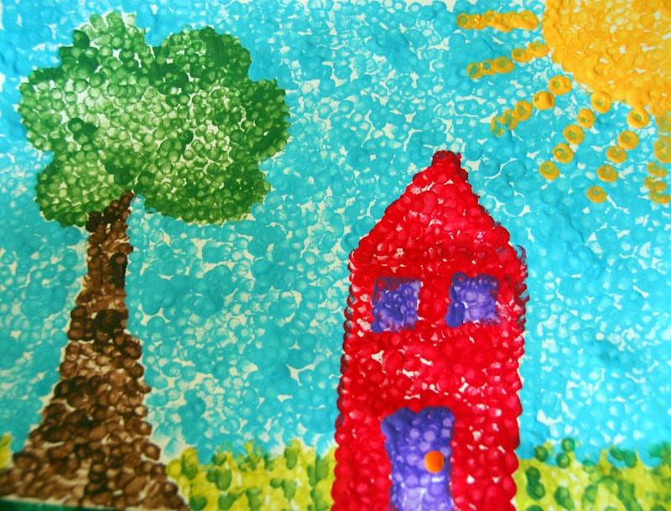
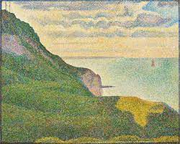
Art and Design: Painting
Art and design area: Painting |  |  |  | Year group: Year 2
How can paint be used to create different effects?
Prior learning | New learning |  | What success looks like: | What success looks like: |  | Future learning
EYFS Know that paint can be applied in different ways. Understand that paint can create different textures. Understand how to change properties of paint using water. Year 1 What are primary and secondary colours? How are colours mixed? How are warm and cool colours used effectively? | To explore creating tints and shades in a variety of different colours. To experiment with different painting effects such as washes, blocking and thickened paint. To explore paint effects and techniques used by famous artists. (Claude Monet and Paul Klee) To explore texture in an artwork using techniques such as layering, differing brush strokes or varying equipment such as a sponge or spatula. To create a final piece that applies two different painting effects. |  | Children independently mix primary colours to make secondary colours Children accurately mixes colours using powder paint and watercolour. Children can explain that adding white to colours creates tints and the adding black to colours creates shades. Children can name different types of paint and know their properties | Children develop effective grip using smaller crayons, pencils and pens. Children describe lines, shapes and patterns created. Children demonstrate control when drawing using chalk, wax crayons, pencils, colouring pencils and felt tips. |  | In Year 3 . . . . To look at how famous artists have used complementary colours to create an artwork. To explore creating tones To create colour wheel that displays tertiary colours. To explore complementary colour combinations. To explore creating hues using watercolour paints.
Key vocabulary | References | References | End Point | End Point | End Point | Artist References | Artist References
Tint- a mixture of a colour with white, which increases lightness. Shade- a mixture with black, which increases darkness. Washes- A term for a visual arts technique resulting in a semi-transparent layer of colour. Blocking- A common and relatively simple method of underpainting that allows an artist to quickly sketch out the work by painting in simple “blocks,” or shapes, of colour. Application- The way in which art materials are transferred to a surface. Textures- Texture refers to the surface quality in a work of art. Texture that is created to look like something it is not, is called visual or implied texture | Drawing- A picture or diagram made with a pencil, pen, or crayon rather than paint. Line- Connection between two points. It can vary in length and size and direction. Shape- the form or outline of something. Observation- the action or process of closely observing or monitoring something or someone. Abstract- modern art which does not represent images of our everyday world. It has colour, lines and shapes (form), but they are not intended to represent objects or living things. |  |  | Know that drawings are marks left behind from dry media. Have experiments using a variety of dry media to create marks. Can name drawing tools; chalk, felt tips, pencils, crayons. | Understands how to create tones and tints with paint. Can create different effects with painting Understands how to change properties of paint, using water. Can discuss artist’s use of painting effects.
Georges Seurat

Slide 16
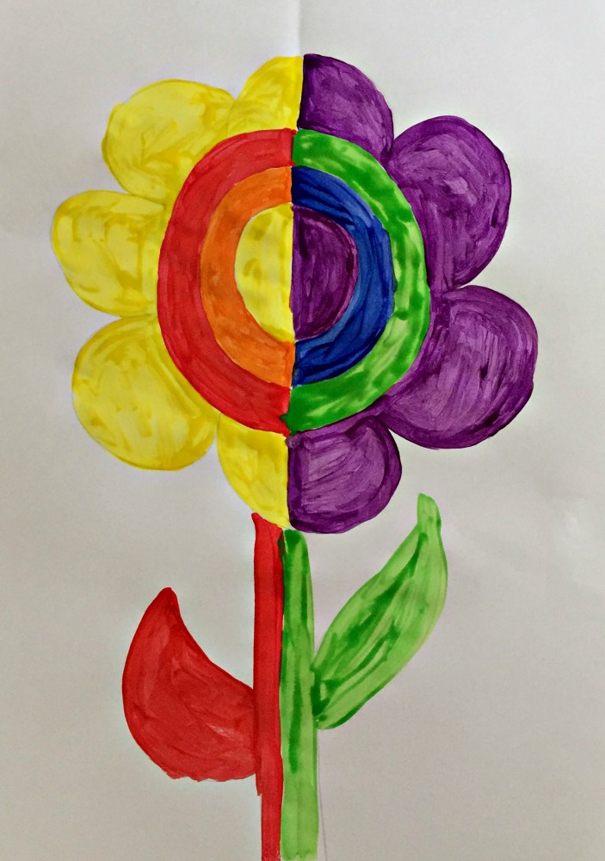
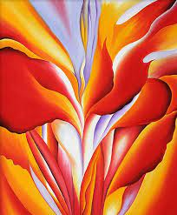
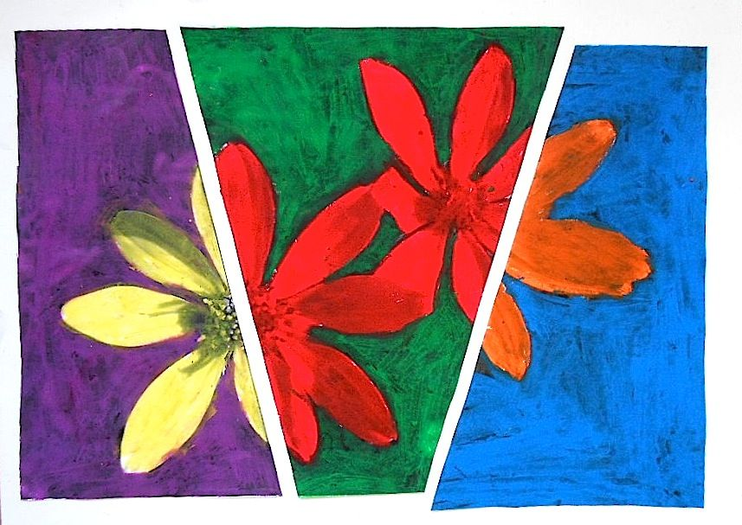
Art and Design: Painting
Art and design area: Painting |  |  | Year group: Year 3
How are complementary colours used in water colour artwork?
Prior learning | New learning |  | What success looks like: |  | Future learning
In Key Stage 1 . . . Year 1- Learnt about primary and secondary colours, warm and cool colours. Created a simple colour wheel. Year 2 - Explain that adding white to colours creates tints and the adding black to colours creates shades. | Experiment with brush techniques (thick and thin brushes to produce shapes, textures, patterns and lines). Mix colours effectively. To explore how famous artists have used complementary colours to create an artwork. To explore creating hues using watercolour paints. To create colour wheel that displays tertiary colours. To explore complementary colour combinations. To create a final piece that uses complementary colours |  | Children work confidently in different scales Children can create pieces of complementary colours Children can work with increased independence and confidence |  | In Year 4. . . . Know how hues are created using water colours. Know what tints, tones and shades are. Combine colours to create tints, tones and shades. Mix and match colours to objects in the natural or man-made forms
Key vocabulary | References | References | End Point | End Point | Artist References | Artist References
Colour wheel- A colour wheel shows you how colours relate to each other and visually demonstrates the relationship between primary, secondary and tertiary colours. Primary colours- The primary colours are those which cannot be created by mixing other colours in a given colour space. Secondary colours- A secondary colour is a colour made by mixing of two primary colours. Tertiary colour- is a colour made by mixing full saturation of one primary colour with half saturation of another primary colour and none of a third primary colour. Complementary colours- Two colours that are on opposite sides of the colour wheel. This combination provides a high contrast and high impact colour combination – together, these colours will appear brighter and more prominent. | Drawing- A picture or diagram made with a pencil, pen, or crayon rather than paint. Line- Connection between two points. It can vary in length and size and direction. Shape- the form or outline of something. Observation- the action or process of closely observing or monitoring something or someone. Abstract- modern art which does not represent images of our everyday world. It has colour, lines and shapes (form), but they are not intended to represent objects or living things. |  | Know that drawings are marks left behind from dry media. Have experiments using a variety of dry media to create marks. Can name drawing tools; chalk, felt tips, pencils, crayons. | Can create a colour wheel independently. Can identify and explain primary, secondary and tertiary colours. Can identify and explain complementary colours. Name key artists that use complementary colours. |  | Georgia O'Keeffe

Slide 17
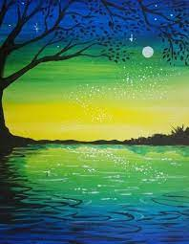
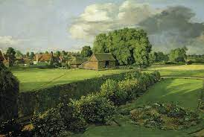
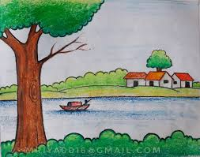
Art and Design: Painting
Art and design area: Painting |  |  | Year group: Year 4
How do you mix colours to match objects?
Prior learning | New learning |  | What success looks like: |  | Future learning
Year 1- Learnt about primary and secondary colours, warm and cool colours. Created a simple colour wheel. Year 2- Learnt to create tints and tones. Year 3- Learnt what primary, secondary and complementary colours are. | Brush techniques are explored to create different effects. To mix and match colours to objects in the natural or man-made forms. Use black and white to lighten and darken tones. To combine colours and create tints, tone and shades to reflect the purpose of the work. To observe colours on hands and faces - mix a range of flesh colours. To mix and blend colours using a soft and smooth gradient. Colours are blended with little visual appearance of intervals Use water colours paint to produce washes for backgrounds then add detail. |  | Children demonstrate control and accuracy when painting using thick and thin paintbrushes and select for purpose. Children know precise colour language e.g. tint, tone, shade, hue Children demonstrate a secure knowledge of primary, secondary, complementary, warm and cold and contrasting colours. |  | In Year 5. . . . To explore how artists express thoughts and feeling through use of colour and application. To mix colours accurately and understand the properties of a range of different paint types. To experiment with different colours that represent moods. To create a mood painting through use of colour and application. Develop watercolour techniques. Mark make with paint (dashes, blocks of colour, strokes, points). Develop fine brush strokes.
Key vocabulary | References | References | End Point | End Point | Artist References | Artist References
Tint- where an artist adds white to a colour to create a lighter version of the colour. Tone- refers to the relative lightness or darkness of a colour. Shade- where an artist adds black to a colour to darken it down. Hue- the origin of the colours we can see. | Drawing- A picture or diagram made with a pencil, pen, or crayon rather than paint. Line- Connection between two points. It can vary in length and size and direction. Shape- the form or outline of something. Observation- the action or process of closely observing or monitoring something or someone. Abstract- modern art which does not represent images of our everyday world. It has colour, lines and shapes (form), but they are not intended to represent objects or living things. |  | Know that drawings are marks left behind from dry media. Have experiments using a variety of dry media to create marks. Can name drawing tools; chalk, felt tips, pencils, crayons. | Understands how hues are created using water colours. Understands what tints, tones and shades are. Can combine colours to create tints, tones and shades. Can mix and match colours to objects in the natural or man-made forms. |  | John Constable

Slide 18
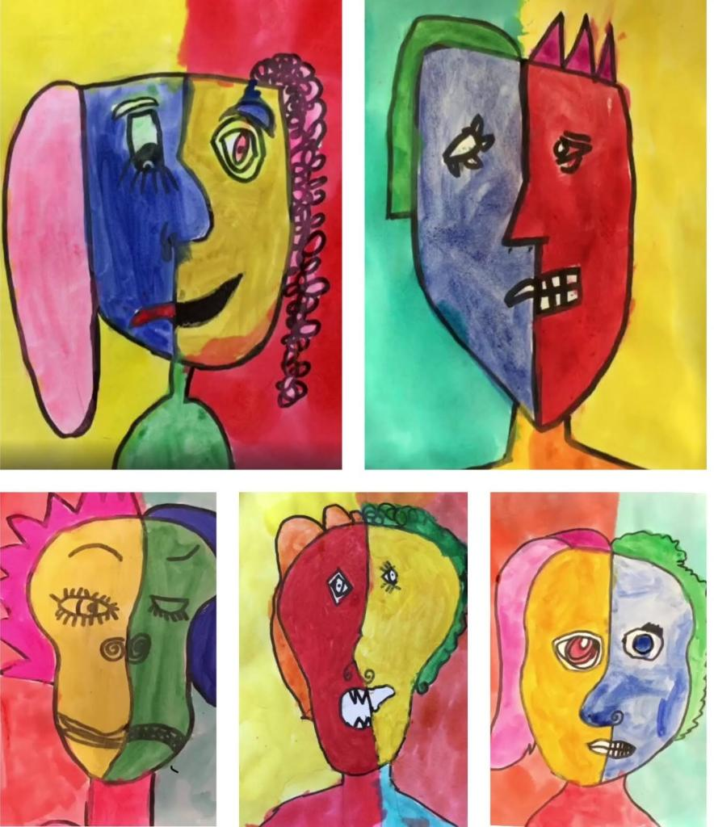
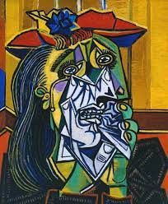
Art and Design: Painting
Art and design area: Painting |  |  | Year group: Year 5
How can I use different colours to represent moods?
Prior learning | New learning |  | What success looks like: |  | Future learning
Year 1- Learnt about primary and secondary colours, warm and cool colours. Created a simple colour wheel. Year 2- Learnt to create tints and tones. Year 3- Learnt what primary, secondary and complementary colours are Year 4 - Learnt to create hues using water colours. | To explore how artists express thoughts and feeling through use of colour and application. To mix colours accurately and understand the properties of a range of different paint types. To experiment with different colours that represent moods. To create a mood painting through use of colour and application. Develop watercolour techniques. Mark make with paint (dashes, blocks of colour, strokes, points). Develop fine brush strokes. |  | Mix colour accurately and make decisions about which type of paint is appropriate for each aspect of their art Talk about how colour creates different moods and can make appropriate choices Create different moods in their work according to the colour used Uses water colours techniques accurately Uses fine brush strokes in own art Understands how an artists uses colour to explore feelings. |  | In Year 6. . . . Know when using a wash (either with water colour or other paint) perspective can be achieved through darkening the paint towards to foreground Choose appropriate paint, paper and implements to adapt and extend their work Mix and match colours to create atmosphere and light effects Be able to identify and work complementary and contrasting colours Experiment with the use of paint to create contemporary art ideas
Key vocabulary | References | References | End Point | End Point | Artist References | Artist References
Tint- where an artist adds white to a colour to create a lighter version of the colour. Tone- refers to the relative lightness or darkness of a colour. Shade- where an artist adds black to a colour to darken it down. Hue- the origin of the colours we can see. | Drawing- A picture or diagram made with a pencil, pen, or crayon rather than paint. Line- Connection between two points. It can vary in length and size and direction. Shape- the form or outline of something. Observation- the action or process of closely observing or monitoring something or someone. Abstract- modern art which does not represent images of our everyday world. It has colour, lines and shapes (form), but they are not intended to represent objects or living things. |  | Know that drawings are marks left behind from dry media. Have experiments using a variety of dry media to create marks. Can name drawing tools; chalk, felt tips, pencils, crayons. | Understands how to colour captures different mood in paintings Understands how to use water colours. Can use colour in own work to create different moods Can use fine brush strokes to complement own work
Pablo Picasso

Slide 19
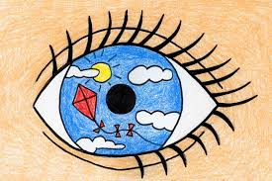
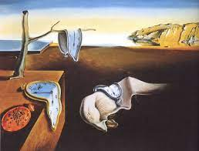
Art and Design: Painting
Art and design area: Painting |  |  | Year group: Year 6
What do we mean by surreal art?
Prior learning | New learning |  | What success looks like: |  | Future learning
Year 1- Learnt about primary and secondary colours, warm and cool colours. Created a simple colour wheel. Year 2- Learnt to create tints and tones. Year 3- Learnt what primary, secondary and complementary colours are Year 4 - Learnt to create hues using water colours. Year 5 – know how to use colour to capture different moods | Know when using a wash (either with water colour or other paint) perspective can be achieved through darkening the paint towards to foreground Choose appropriate paint, paper and implements to adapt and extend their work Mix and match colours to create atmosphere and light effects Be able to identify and work complementary and contrasting colours Experiment with the use of paint to create surreal art ideas |  | Applies wash appropriately and knows how to paint onto a wash background Chooses appropriate paper, paint and brushes for a given task.. Create atmosphere in own work by using appropriate colour and brush strokes Knows how to make use of contrasting and complementary colours |  | In Year 7. . . . Explore and investigate a range of paints and know the techniques and processes involved with each Colour mixing methods with a range of materials, techniques and processes Colour symbolism and connotations Increasing control with painting with adventurous development, using an increasing variety of tools to create specific effects
Key vocabulary | References | References | End Point | End Point | Artist References | Artist References
Tint- where an artist adds white to a colour to create a lighter version of the colour. Tone- refers to the relative lightness or darkness of a colour. Shade- where an artist adds black to a colour to darken it down. Hue- the origin of the colours we can see. | Drawing- A picture or diagram made with a pencil, pen, or crayon rather than paint. Line- Connection between two points. It can vary in length and size and direction. Shape- the form or outline of something. Observation- the action or process of closely observing or monitoring something or someone. Abstract- modern art which does not represent images of our everyday world. It has colour, lines and shapes (form), but they are not intended to represent objects or living things. |  | Know that drawings are marks left behind from dry media. Have experiments using a variety of dry media to create marks. Can name drawing tools; chalk, felt tips, pencils, crayons. | Understands how to colour captures different mood in paintings Understands how to use water colours. Can use colour in own work to create different moods Can use fine brush strokes to complement own work
Salvador Dali

Slide 20
Progression Map for Painting
Nursery | Reception | Year 1 | Year 2
To experiment with a range of painting tools such as thick and thin paintbrushes, spatulas, combs, toothbrushes. To explore and experiment with making marks using all paint tools above. To explore colour mixing using poster paint. | To experiment with a range of painting tools such as thick or thin paintbrushes, fingers, spatulas, combs, toothbrushes etc. To name a range of different colours. To mix paint to match colours they see. To explore and refine colour mixing using poster paint. To combine paint and collage. To offer viewpoints of paintings. | To explore primary and secondary colours. To represent primary and secondary colours on a colour wheel. To identify and experiment with warm and cool colours. To paint from observation. To explore primary and secondary colours. To represent primary and secondary colours on a colour wheel. To identify and experiment with warm and cool colours. To paint from observation. | To explore creating tints and shades in a variety of different colours. To experiment with different painting effects such as washes, blocking and thickened paint. To explore paint effects and techniques used by famous artists. (Claude Monet and Paul Klee) To explore texture in an artwork using techniques such as layering, differing brush strokes or varying equipment such as a sponge or spatula, pointillism. To create a final piece that applies two different painting effects.
Year 3 | Year 4 | Year 5 | Year 6
Experiment with brush techniques (thick and thin brushes to produce shapes, textures, patterns and lines). Mix colours effectively. To explore how famous artists have used complementary colours to create an artwork. To explore creating hues using watercolour paints. To create colour wheel that displays tertiary colours. To explore complementary colour combinations. To create a final piece that uses complementary colours | Brush techniques are explored to create different effects. To mix and match colours to objects in the natural or man-made forms. Use black and white to lighten and darken tones. To combine colours and create tints, tone and shades to reflect the purpose of the work. To observe colours on hands and faces - mix a range of flesh colours. To mix and blend colours using a soft and smooth gradient. Colours are blended with little visual appearance of intervals Use water colours paint to produce washes for backgrounds then add detail. | To explore how artists express thoughts and feeling through use of colour and application. To mix colours accurately and understand the properties of a range of different paint types. To experiment with different colours that represent moods. To create a mood painting through use of colour and application. Develop watercolour techniques. Mark make with paint (dashes, blocks of colour, strokes, points). Develop fine brush strokes. | Know when using a wash (either with water colour or other paint) perspective can be achieved through darkening the paint towards to foreground Choose appropriate paint, paper and implements to adapt and extend their work Mix and match colours to create atmosphere and light effects Be able to identify and work complementary and contrasting colours Experiment with the use of paint to create surreal art ideas.

Slide 21
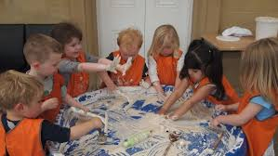
Art and Design: Sculpture
Art and design area: Sculpture |  | Year group: Nursery
What is a sculpture?
Prior learning | New learning | What success looks like: | Future learning
N/A | Manipulate materials to achieve a planned effect. Select tools and techniques needed to shape, assemble and join materials they are using. | Children will begin to know which tools to use for particular activities. Children will manipulate materials to achieve a planned effect. | In Reception: Children use their hands to manipulate malleable materials in different ways, rolling, kneading, squashing, pinching They begin to arrange blocks, boxes in different ways- stacking, lining up, enclosure They create models using recycled materials. They work with other children to create a group piece of work.
Key vocabulary | References | End Point | Artist References
Roll Join Glue Shape tools |  | Have experienced creating sculptures for artwork using a range of different materials.

Slide 22
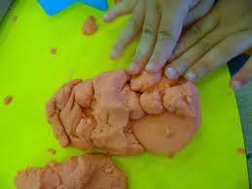
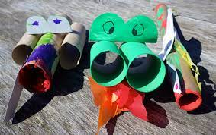
Art and Design: Sculpture
Art and design area: Sculpture |  | Year group: Reception
What is a sculpture?
Prior learning | New learning | What success looks like: |  | Future learning
In Nursery . . . Children manipulate materials to achieve a planned effect. They select tools and techniques needed to shape, assemble and join materials they are using. | To use hands to manipulate malleable materials in different ways, rolling, kneading, squashing, pinching To begin to arrange blocks, boxes in different ways- stacking, lining up, enclosure To create models using recycled materials. To work with other children to create a group piece of work. | Can knead, squash, roll, pinch malleable materials. Can arrange boxes, blocks in a line, as a stack or to create an enclosure. |  | In Year 1. . . Children will manipulate malleable materials in a variety of ways i.e., rolling, joining and kneading They will use joining techniques of gluing, pins, staples and threading They will work with others to create a group piece of artwork using recycled materials. They communicate reasons, thoughts, observations and feelings. They create models using recycled materials.
Key vocabulary | References | End Point | End Point | Artist References | Artist References
Malleable Roll Knead Squash Pinch Joining Gluing Staples |  | Know that drawings are marks left behind from dry media. Have experiments using a variety of dry media to create marks. Can name drawing tools; chalk, felt tips, pencils, crayons. | Have experienced creating sculptures for artwork using a range of different materials. Have worked as part of a team and individually to create a sculpture.

Slide 23
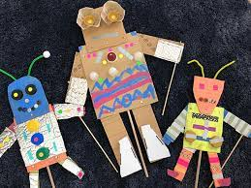
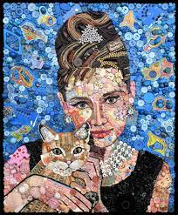
Art and Design: Sculpture
Art and design area: Sculpture |  |  | Year group: Year 1
What do we mean by using recycled materials for art?
Prior learning | New learning | What success looks like: | What success looks like: |  | Future learning
In Reception . . . Children use hands to manipulate malleable materials in different ways, rolling, kneading, squashing, pinching They begin to arrange blocks, boxes in different ways- stacking, lining up, enclosure They create models using recycled materials. They work with other children to create a group piece of work. | To manipulate malleable materials in a variety of ways i.e. rolling, joining and kneading To use joining techniques of gluing, pins, staples and threading To work with others to create a group piece of artwork using recycled materials. To communicate reasons, thoughts, observations and feelings. To create models using recycled materials. | *Children confidently handle clay and know how to roll it, knead it and make good attempts at joining it. *They begin to use a range of joining techniques successfully. *They work well as a group and agree on ways forward. * They use a range of recycled materials to create models that have meaning to them. | Children develop effective grip using smaller crayons, pencils and pens. Children describe lines, shapes and patterns created. Children demonstrate control when drawing using chalk, wax crayons, pencils, colouring pencils and felt tips. |  | In Year 2 . . . . Children explore arrangements using natural materials. They twist, knot, tie, intertwine and construct using natural materials. They observe and use colours, textures, shapes and patterns in natural materials. They work with others to create a group piece of artwork using natural materials. They communicate reasons, thoughts, observations and feelings about work created. They explore and experiment with other sculpting materials.
Key vocabulary | References | End Point | End Point | End Point | Artist References | Artist References
Malleable Rolling Joining Kneading Gluing Staples Recycle Natural materials Textures Artists Sculptures |  |  | Know that drawings are marks left behind from dry media. Have experiments using a variety of dry media to create marks. Can name drawing tools; chalk, felt tips, pencils, crayons. | Understands that sculptures can be made from anything. Can describe how artists have used found materials to create sculptures. |  | Jane Perkins

Slide 24
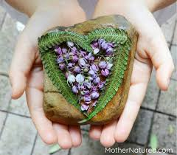
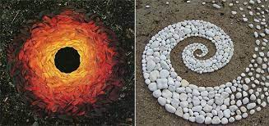
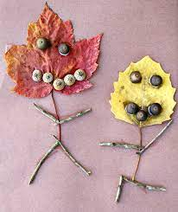
Art and Design: Sculpture
Art and design area: Sculpture |  |  | Year group: Year 2
How can we create art with natural materials?
Prior learning | New learning | What success looks like: | What success looks like: |  | Future learning
In Year 1 . . . Children manipulate malleable materials in a variety of ways i.e. rolling, joining and kneading They use joining techniques of gluing, pins, staples and threading They work with others to create a group piece of artwork using recycled materials. They communicate reasons, thoughts, observations and feelings. They create models using recycled materials. | To explore arrangements using natural materials. To twist, knot, tie, intertwine and construct using natural materials. To observe and use colours, textures, shapes and patterns in natural materials. Work with others to create a group piece of artwork using natural materials. Communicate reasons, thoughts, observations and feelings about work created. Explore and experiment with other sculpting materials. | Children are very familiar with a range of natural materials and can use them to create own ideas. They can talk about different textures and make choices about which are most appropriate in different circumstances. They begin to recognise that using natural materials can be artistic just as much as a painting is. | Children develop effective grip using smaller crayons, pencils and pens. Children describe lines, shapes and patterns created. Children demonstrate control when drawing using chalk, wax crayons, pencils, colouring pencils and felt tips. |  | In Year 3 . . . . Children use and explore clay and experiment with mark making tools. They press shapes into clay, engrave shapes and textures using tools. They use sketchbook to plan and develop ideas They use coiling technique
Key vocabulary | Expectations | End Point | End Point | End Point | Artist References | Artist References
Rolling Joining Gluing Textures Twisting Creating Communicate Explore Experiment Pattern Coiling |  |  | Know that drawings are marks left behind from dry media. Have experiments using a variety of dry media to create marks. Can name drawing tools; chalk, felt tips, pencils, crayons. | Know about famous sculptors who used natural materials. Recall how they have created a sculpture using natural materials.
Andy Goldsworthy

Slide 25
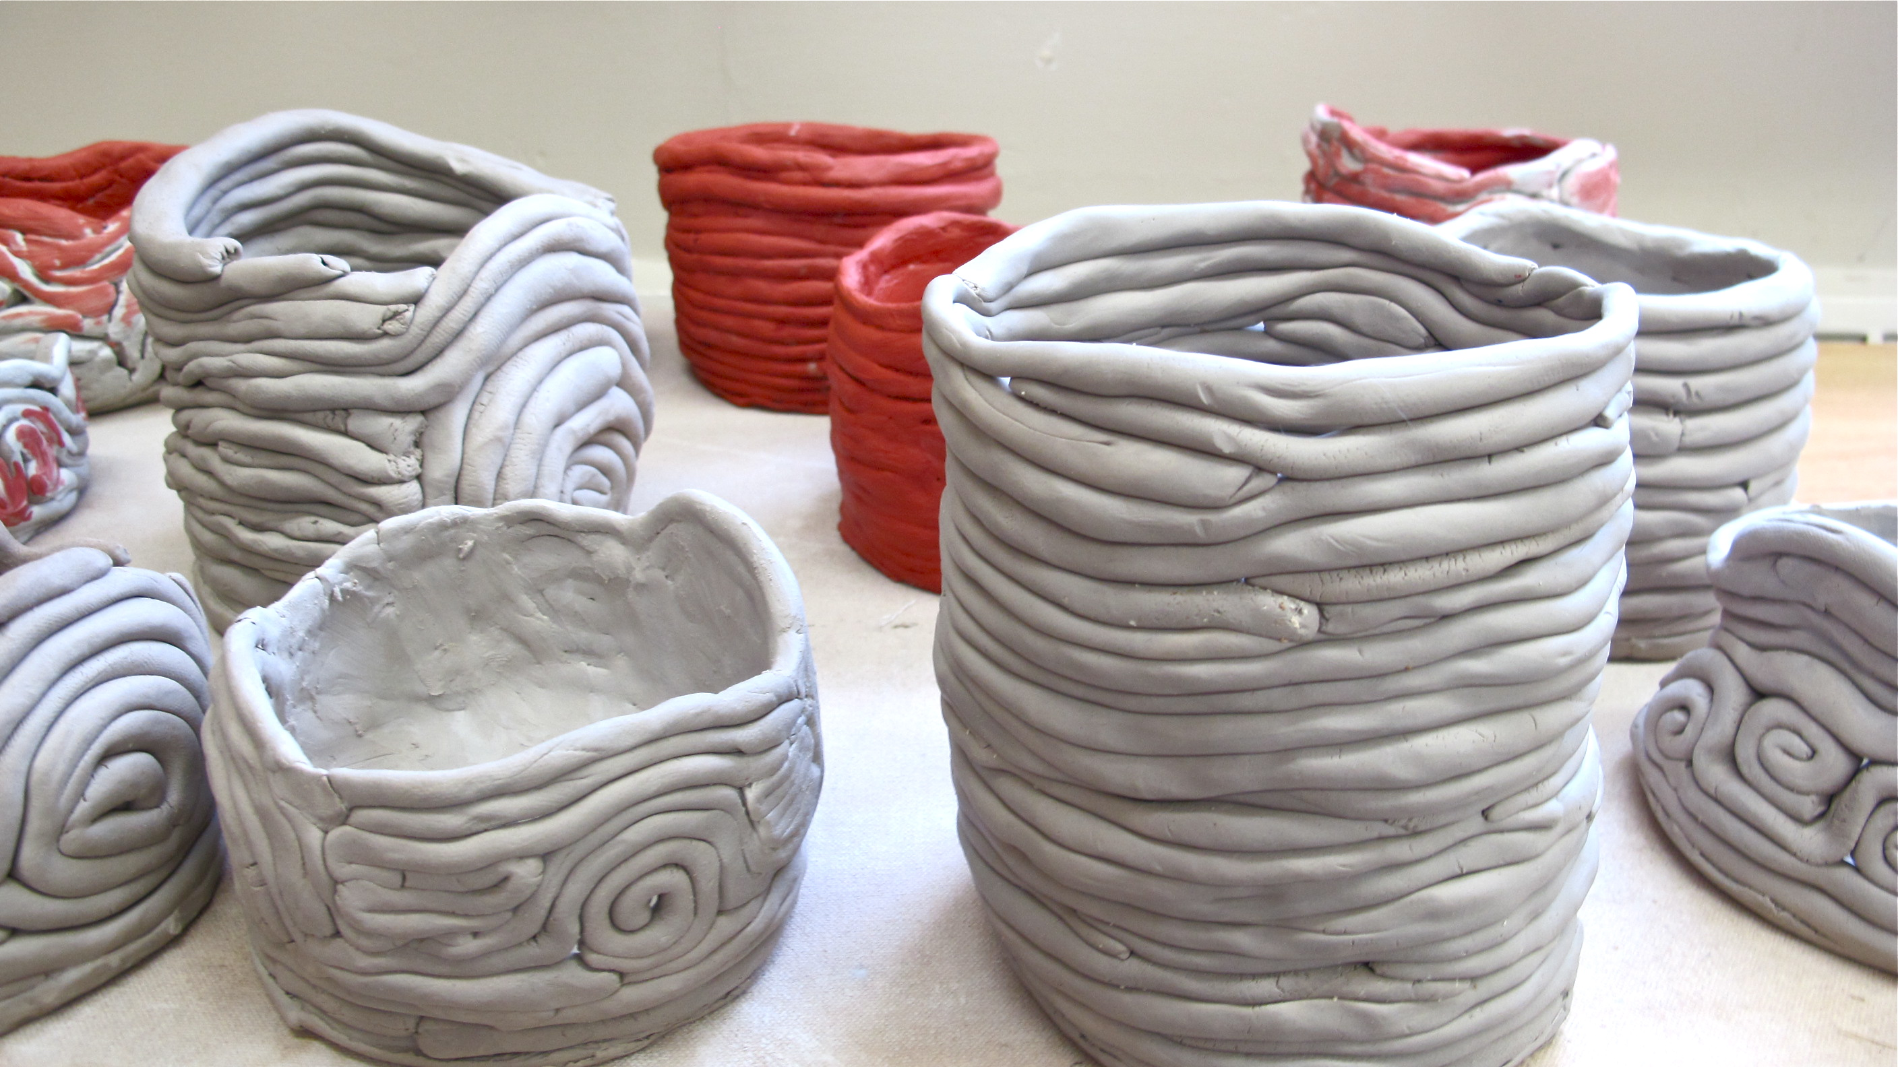
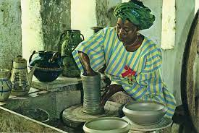
Art and Design: Sculpture
Art and design area: Sculpture |  |  | Year group: Year 3
How can we explore clay using different techniques?
Prior learning | New learning |  | What success looks like: |  | Future learning
In Year 2 . . . Children explore arrangements using natural materials. They twist, knot, tie, intertwine and construct using natural materials. They observe and use colours, textures, shapes and patterns in natural materials. They work with others to create a group piece of artwork using natural materials. They communicate reasons, thoughts, observations and feelings about work created. They explore and experiment with other sculpting materials. | To use and explore clay and experiment with mark making tools. To press shapes into clay, engrave shapes and textures using tools. To use sketchbook to plan and develop ideas To use coiling technique |  | Children demonstrate a good technique when making coils from clay. They have an idea how clay joins together to create a permanent bond. They can roll clay and press shapes into it. They use their sketchbooks to support their ideas. |  | In Year 4. . . . Children shape, form, model and construct sculptures from paper Children explore paper techniques such as origami to create 3D models Children use paper mâché to create 3D models They explore and experiment with other forms of sculpture
Key vocabulary | References | Expectations | End Point | End Point | Artist References | Artist References
Shape Construct Sculpture Coiling Sketchbook Technique Experiment Press Slip (as related to clay) Slab (as related to clay) Score (as related to clay) | Drawing- A picture or diagram made with a pencil, pen, or crayon rather than paint. Line- Connection between two points. It can vary in length and size and direction. Shape- the form or outline of something. Observation- the action or process of closely observing or monitoring something or someone. Abstract- modern art which does not represent images of our everyday world. It has colour, lines and shapes (form), but they are not intended to represent objects or living things. |  | Know that drawings are marks left behind from dry media. Have experiments using a variety of dry media to create marks. Can name drawing tools; chalk, felt tips, pencils, crayons. | Can explain key vocabulary coil, score, slip and slab. Can recall steps to create their 3D clay sculpture. |  | Ladi Kwali

Slide 26
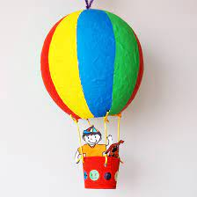
Art and Design: Sculpture
Art and design area: Sculpture |  |  | Year group: Year 4
How can we create sculptures from paper?
Prior learning | New learning |  | What success looks like: |  | Future learning
In Year 3 … Children use and explore clay and experiment with mark making tools. They press shapes into clay, engrave shapes and textures using tools. They use their sketchbook to plan and develop ideas They learn to use coiling technique | Shape, form, model and construct sculptures from paper Explore paper techniques such as origami to create 3D models Use paper mâché to create 3D models Explore and experiment with other forms of sculpture |  | Children know about a range of artists who use paper as they main medium. They have experienced origami and tried to create some examples. They know what paper mâché’ is and can create their own knowing about the texture, etc. They know about different forms of sculpture and have experience of some. |  | In Year 5. . . . Children explore wire as a medium for sculptures. They use aluminium wire to create sculptures They shape, form, model and construct using wire They use tools safely They explore and experiment with other forms of sculpture
Key vocabulary | References | Expectations | End Point | End Point | Artist References | Artist References
Origami Pare Mache’ Sculpture Construct Experiment Sketchbooks Texture Aesthetically pleasing | Drawing- A picture or diagram made with a pencil, pen, or crayon rather than paint. Line- Connection between two points. It can vary in length and size and direction. Shape- the form or outline of something. Observation- the action or process of closely observing or monitoring something or someone. Abstract- modern art which does not represent images of our everyday world. It has colour, lines and shapes (form), but they are not intended to represent objects or living things. |  | Know that drawings are marks left behind from dry media. Have experiments using a variety of dry media to create marks. Can name drawing tools; chalk, felt tips, pencils, crayons. | Understands that paper can be used in a range of different ways to create a sculpture. Can explain the process of how to create a paper mâché sculpture. |  | Bernie Kaminski

Slide 27
Art and Design: Sculpture
Art and design area: Sculpture |  |  | Year group: Year 5
How do I create a 3D sculpture from wire?
Prior learning | New learning |  | What success looks like: |  | Future learning
Children know about a range of artists who use paper as they main medium. They have experienced origami and tried to create some examples. They know what paper Mache’ is and can create their own knowing about the texture, etc. They know about different forms of sculpture and have experience of some. | Explore wire as a medium for sculptures. Use aluminium wire to create sculptures Shape, form, model and construct using wire Use tools safely Explore and experiment with other forms of sculpture |  | Children know about a number of sculptors and how they worked. They know how to use wire to create their own sculptures. They can shape and model using wire. They know how to add paper Mache’ or modroc to create a 3D effect. They know how to use tools carefully and safely. |  | In Year 6. . . . Children will create sculptures using, clay, wire, paper mâché and other man-made and natural materials. They will use sketchbook to inform, plan and develop ideas. They will shape, form, model and join with confidence. They will use paper mâché to create 3D models They compare ideas, methods and approaches to their own and others’ work and say what they think and feel about it They adapt work according to their views and describe how they might develop it further
Key vocabulary | References | Expectations | End Point | End Point | Artist References | Artist References
Sculpture Wire Safety Aluminium Sculptors | Drawing- A picture or diagram made with a pencil, pen, or crayon rather than paint. Line- Connection between two points. It can vary in length and size and direction. Shape- the form or outline of something. Observation- the action or process of closely observing or monitoring something or someone. Abstract- modern art which does not represent images of our everyday world. It has colour, lines and shapes (form), but they are not intended to represent objects or living things. |  | Know that drawings are marks left behind from dry media. Have experiments using a variety of dry media to create marks. Can name drawing tools; chalk, felt tips, pencils, crayons. | Explain how to use tools safely to create wire sculptures. Know about famous wire sculptors and can discuss their work confidently. |  | Elizabeth Berrien

Slide 28
Art and Design: Sculpture
Art and design area: Sculpture |  |  |  | Year group: Year 6
How can I manipulate clay effectively to create a sculpture?
Prior learning | New learning |  | What success looks like: | What success looks like: |  | Future learning
From the previous year, children know about a number of sculptors and how they worked. They know how to use wire to create their own sculptures. They can shape and model using wire. They know how to add paper Mache’ or modroc to create a 3D effect. They know how to use tools carefully and safely. | Create sculptures using, clay, wire, paper mâché and other man-made and natural materials. Use sketchbook to inform, plan and develop ideas. Shape, form, model and join with confidence. Use paper mâché to create 3D models Compare ideas, methods and approaches to their own and others’ work and say what they think and feel about it Adapt work according to their views and describe how they might develop it further. |  | Children feel confident in using clay, wire, paper Mache’, and other man-made and natural materials to create their sculptures. They use sketchbooks with increasing confidence to plan out their final sculpture. They work in groups, if needed, and share ideas. They are able to talk about their ideas and make adaptation when required to do so. | Children feel confident in using clay, wire, paper mache’, and other man-made and natural materials to create their sculptures. They use sketchbooks with increasing confidence to plan out their final sculpture. They work in groups, if needed, and share ideas. They are able to talk about their ideas and make adaptation when required to do so. |  | In Year 7. . . Pupils will explore and investigate a range of materials, techniques and processes They will critically and technically analyse and evaluate their own and others work, identify key features, make comparisons and use this information to inform developments They will develop and use creative, critical and technical language, using quality talk and speak like an artist They will know about art, craft and design of different periods and cultures, understanding the development of the work, the context of the artists, as well as the historical, political, spiritual, cultural, social, moral, environmental context(s) in which the work(s) was, were or are created.
Key vocabulary | References | Expectations |  | End Point | End Point | Artist References | Artist References
Sculptures Paper Mache’ Natural materials Join Model Sketchbooks Discussion Collaboration Modroc Safe handling | Drawing- A picture or diagram made with a pencil, pen, or crayon rather than paint. Line- Connection between two points. It can vary in length and size and direction. Shape- the form or outline of something. Observation- the action or process of closely observing or monitoring something or someone. Abstract- modern art which does not represent images of our everyday world. It has colour, lines and shapes (form), but they are not intended to represent objects or living things. |  |  | Know that drawings are marks left behind from dry media. Have experiments using a variety of dry media to create marks. Can name drawing tools; chalk, felt tips, pencils, crayons. | Explain that sculptures can be made out of a range of different materials and can recall materials used in previous years. Know a range of sculpting artists.
Johnson Tsang

Slide 29
Progression Map for Sculpture
Nursery | Reception | Year 1 | Year 2
Manipulate materials to achieve a planned effect. Select tools and techniques needed to shape, assemble and join materials they are using. | To use hands to manipulate malleable materials in different ways, rolling, kneading, squashing, pinching To begin to arrange blocks, boxes in different ways- stacking, lining up, enclosure To create models using recycled materials. To work with other children to create a group piece of work. | To manipulate malleable materials in a variety of ways i.e. rolling, joining and kneading To use joining techniques of gluing, pins, staples and threading To work with others to create a group piece of artwork using recycled materials. To communicate reasons, thoughts, observations and feelings. To create models using recycled materials. | To explore arrangements using natural materials. To twist, knot, tie, intertwine and construct using natural materials. To observe and use colours, textures, shapes and patterns in natural materials. Work with others to create a group piece of artwork using natural materials. Communicate reasons, thoughts, observations and feelings about work created. Explore and experiment with other sculpting materials.
Year 3 | Year 4 | Year 5 | Year 6
To use and explore clay and experiment with mark making tools. To press shapes into clay, engrave shapes and textures using tools. To use sketchbook to plan and develop ideas To use coiling technique | Shape, form, model and construct sculptures from paper Explore paper techniques such as origami to create 3D models Use paper mâché to create 3D models Explore and experiment with other forms of sculpture | Explore wire as a medium for sculptures. Use aluminium wire to create sculptures Shape, form, model and construct using wire Use tools safely Explore and experiment with other forms of sculpture | Create sculptures using, clay, wire, paper mâché and other man-made and natural materials. Use sketchbook to inform, plan and develop ideas. Shape, form, model and join with confidence. Use paper mâché to create 3D models Compare ideas, methods and approaches to their own and others’ work and say what they think and feel about it Adapt work according to their views and describe how they might develop it further

Slide 30
Lesson 1
Link and research the artist
This is a stage where we consider prior knowledge, links to personal experience or links to another subject. It is an important stage in relation to long term memory. Children to focus on a specific artist and evaluate their work. This will act as the title page for the unit.
Lesson 6
Evaluate
Once completed, pupils should be encouraged to evaluate their final pieces, making reference to how they have varied or added aspects to their final pieces. This should be in their sketch books. Children can peer evaluate at this opportunity.
Lesson 2
Research the genre
This is where children will expand their knowledge and look at the genre, outside of the artist. They will annotate some of their work with the aim to develop this technique. Some genres may be surrealism, water colour or landscape.
Art and Design -
stage by stage development
Lesson 5
Create a final piece
This is where the pupil is expected to make use of the knowledge gained to create their own final piece based on the artist or technique being developed. This should be something they are aiming to put into an exhibition or a showcase.
Lesson 3 and 4
Develop the specific technique
Focus on the techniques you want the children to learn. Children to identify these techniques from the previous two pages in their skecthbooks. Children to learn the technique in lesson 3 and apply it in lesson 4. Lesson 4 will act as their draft for the final piece.

